Slide 1
Summer Olympic games winners (1896-2008)

Slide 2
Subject area description
Summer Olympic Games is sport event that is held every four years in different cities. First Olympic Games were held in 1896 in Athens, Greece. There are 42 different Olympic sports (Archery, Athletics, Aquatics, Gymnastics, Wrestling, Boxing, Rowing, etc.) that include 55 different disciplines (for example, Athletics include Gymnastics includes Artistic G., Rhythmic G. and Trampoline). In all these 55 discipline there are over 650 events (for example, Swimming includes 100m butterfly, marathon 10km, 800m freestyle, 200m breaststroke, etc.). Sportsmen (men and women) from more than 140 countries take part in Olympic Games every year. Winners in every kind of sport get medals (gold, silver, bronze). If their results better than existing Olympic and world records such results announced to be new records.

Slide 3
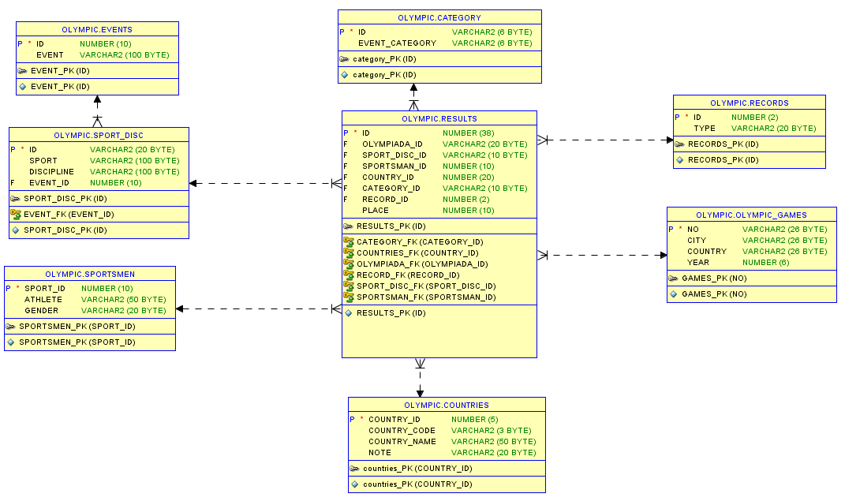

Slide 4

Reports
Top-3 disciplines with the biggest amount of records in each category (Olympic records and World record).
The result is: Athletics, Rowing and Swimming are top-3 disciplines in which there the biggest number of Olympic and World records.

Slide 5
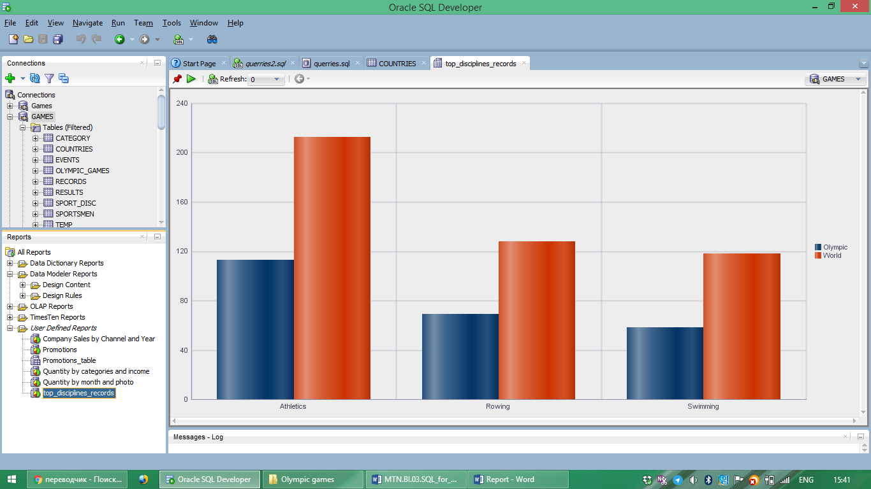

Slide 6
Top-5 athletes and their appropriate kinds of sport that got the biggest number of medals in whole history of Olympic Games
ATHLETE | DISCIPLINE | PLACE | NUM_MEDALS
ANDRIANOV, Nikolay | Artistic G. | 1 | 7
ANDRIANOV, Nikolay | Artistic G. | 2 | 5
ANDRIANOV, Nikolay | Artistic G. | 3 | 3
ANDRIANOV, Nikolay | Artistic G. | Total | 15
FISCHER, Birgit | Canoe / Kayak F | 1 | 8
FISCHER, Birgit | Canoe / Kayak F | 2 | 4
FISCHER, Birgit | Canoe / Kayak F | Total | 12
KATO, Sawao | Artistic G. | 1 | 8
KATO, Sawao | Artistic G. | 2 | 3
KATO, Sawao | Artistic G. | 3 | 1
KATO, Sawao | Artistic G. | Total | 12
LATYNINA, Larisa | Artistic G. | 1 | 9
LATYNINA, Larisa | Artistic G. | 2 | 5
LATYNINA, Larisa | Artistic G. | 3 | 4
LATYNINA, Larisa | Artistic G. | Total | 18
MANGIAROTTI, Edoardo | Fencing | 1 | 6
MANGIAROTTI, Edoardo | Fencing | 2 | 5
MANGIAROTTI, Edoardo | Fencing | 3 | 2
MANGIAROTTI, Edoardo | Fencing | Total | 13
NEMOV, Alexei | Artistic G. | 1 | 4
NEMOV, Alexei | Artistic G. | 2 | 2
NEMOV, Alexei | Artistic G. | 3 | 6
NEMOV, Alexei | Artistic G. | Total | 12
NURMI, Paavo | Athletics | 1 | 9
NURMI, Paavo | Athletics | 2 | 3
NURMI, Paavo | Athletics | Total | 12
ONO, Takashi | Artistic G. | 1 | 5
ONO, Takashi | Artistic G. | 2 | 4
ONO, Takashi | Artistic G. | 3 | 4
ONO, Takashi | Artistic G. | Total | 13
PHELPS, Michael | Swimming | 1 | 14
PHELPS, Michael | Swimming | 3 | 2
PHELPS, Michael | Swimming | Total | 16
SHAKHLIN, Boris | Artistic G. | 1 | 7
SHAKHLIN, Boris | Artistic G. | 2 | 4
SHAKHLIN, Boris | Artistic G. | 3 | 2
SHAKHLIN, Boris | Artistic G. | Total | 13
THOMPSON, Jenny | Swimming | 1 | 8
THOMPSON, Jenny | Swimming | 2 | 3
THOMPSON, Jenny | Swimming | 3 | 1
THOMPSON, Jenny | Swimming | Total | 12
TORRES, Dara | Swimming | 1 | 4
TORRES, Dara | Swimming | 2 | 4
TORRES, Dara | Swimming | 3 | 4
TORRES, Dara | Swimming | Total | 12

Slide 7
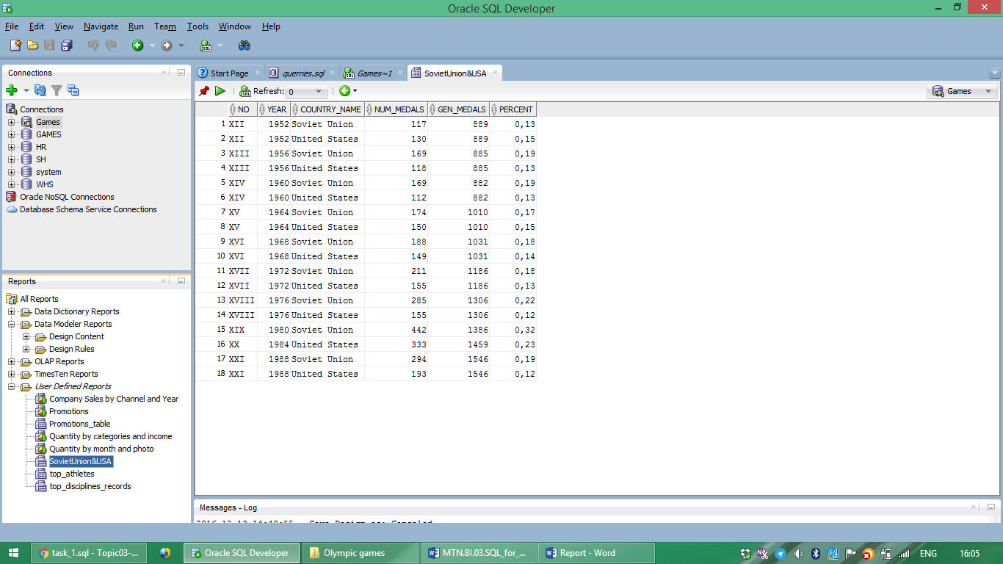
The amount and percent of medals that were got by sportsmen from USA and Soviet Union.
The result is: sportsmen from Soviet Union almost every year got more medals.

Slide 8
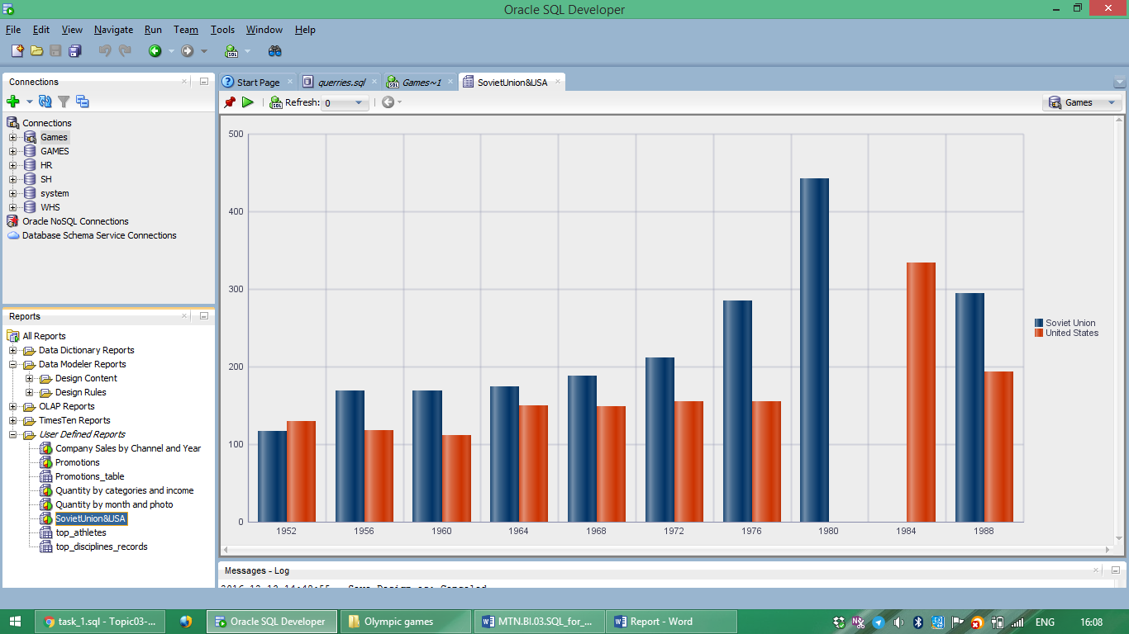

Slide 9

Countries that have the biggest amount of medals in each kind of team sport like football, volleyball, basketball, etc.

Slide 10
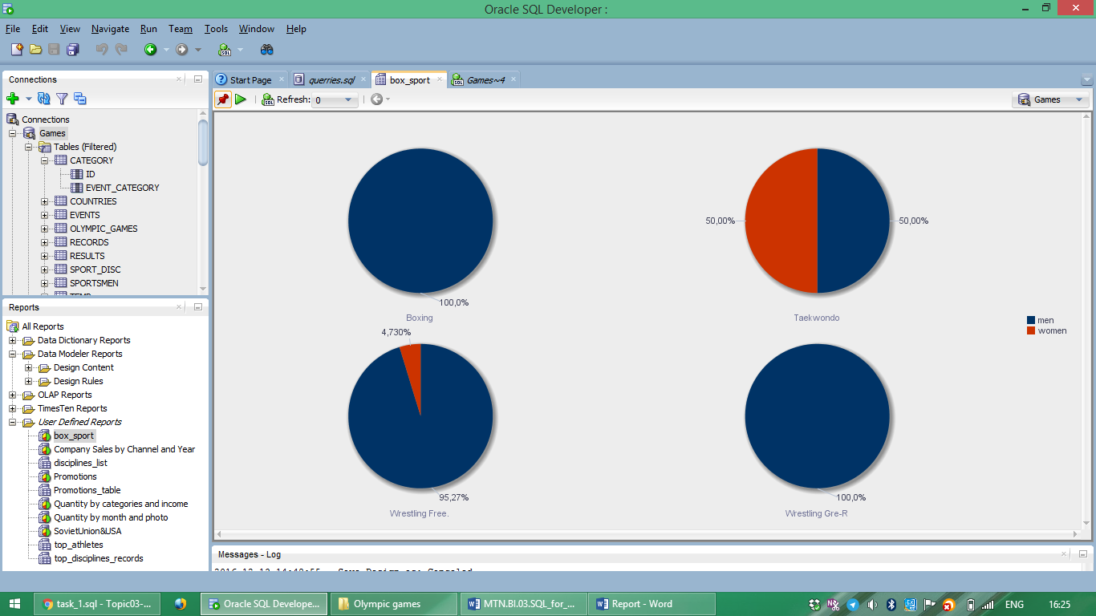
The amount of medals in such sport as Boxing, Wrestling, Taekwondo that got men and women.

Slide 11
Countries that have been in top-10 in medal standings for recent 20 years (their were in top-10 during last 5-6 Olympic Games)
United States
China
Germany
South Korea
Australlia

Slide 12
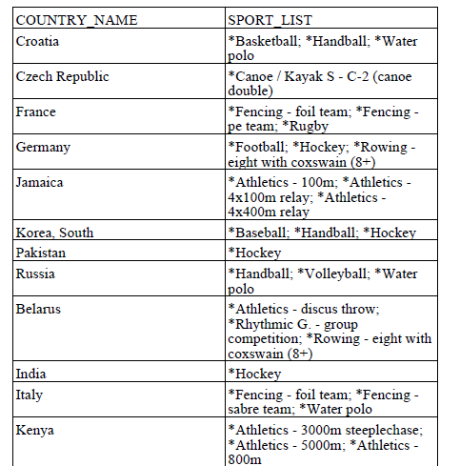
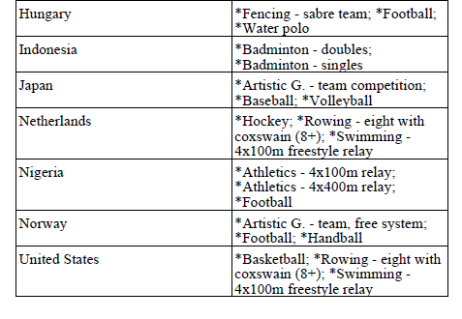
The list of top-3 disciplines in which sportsmen were successful. Such list was generated for each country

